Slide 1
Secure Banking Transaction using Block chain Technology

Slide 2
ABSTRACT
In the era of the digital economy, everyone is forced to convert to a digital transaction and payment modes.
Though it has many merits to its list, there is a critical element called security which is a significant concern for both the service provider and the end-user.
Hence this project provides a holistic understanding of the application of blockchain technology in the banking sector.
Blockchain technology is a boon for the banking sector that mainly involves secured transactions.
This project will discuss the meaning, steps, types, and application of blockchain technology in the banking sector.
Proposed system proposes blockchain technology and its role in ensuring secured banking transactions.

Slide 3
OBJECTIVES
The world is changing incredibly fast, and we are not all aware of it.
Block chain technology and crypto-currencies are an irreversible advancement that is disrupting established industries and the ways in which we interact financially.
For that reason, I believe understanding and being aware of this block chain wave is incredibly important.
The existing systems work as centralized architecture in database system.

Slide 4
PROJECT SCOPE
In order to overcome weaknesses and inconvenience of online banking security, our pro- posed authentication system is designed to provide greater security and convenience by using user & transaction verification, authentication server & authorization.
To address existing security problem, we implementation of a trusted framework for online banking in public cloud using multi-factor authentication using Blockchain Framework.
To design and develop an own (custom) blockchain to store all transaction records in se- cure manner.
Deploy a dynamic smart contract with consensus algorithm to enhance the transaction clarity to end user.

Slide 5
DOMAIN INTRODUCTION
A block chain is a growing list of records called blocks, that are linked using cryptography.
Each block contains a cryptographic hash of the previous block and a timestamp.
It is resistant to modification of the data

Slide 6
LITERATURE SURVEY
SURVEY | AUTHOR | YEAR | EXPLANATION
SURVEY 1: Electronic Health Record System using Blockchain | B.Harshini | 2020 | The data is encrypted by the algorithm known as SHA-256 which is used to encrypt all the data of the patients into a single line 256 bit encrypted text. Cons: : Less Secure due to its 256 Standards
SURVEY 2: Electronic Health Records using Blockchain Technology | Arlindo F. da Conceic¸ao | 2019 | propose the implementation of a large-scale information architecture to access Electronic Health Records (Land Recordss) based on Smart Contracts as information mediators. Cons: : Health Record validation delay and false sense of security
Survey 3: Analysis of Blockchain in the Healthcare Sector: Application and Issues | Dsv madala etal.,,, | 2022 | o investigate how blockchain technology can be applied to improve the overall performance of the healthcare sector Cons: low scalability and less transaction

Slide 7
LITERATURE SURVEY (CONT…)
SURVEY | AUTHOR | YEAR | EXPLANATION
SURVEY :4 Electronic health records and blockchain interoperability requirements: a scoping review | Suzanna Schmeelk | 2022 | We conducted a literature search in the OVID databases (Medline and Embase) on terms blockchain, implementation, interoperability, Land Recordss, security, and standards. Cons : False sense of security due to frequent Database.
SURVEY 5: Blockchain-based Electronic Health Records Management A Comprehensive Review and Future Research Direction | Mamun, Abdullah Al | 2022 | The study examined 99 papers that were collected from various publication categories. The deep technical analysis focused on evaluating articles based on privacy, security, scalability, accessibility, cost, consensus algorithms. Cons: No Specific solution proposed to overcome the issues.

Slide 8
PROBLEM DEFINITION
Banking industry represents the major part of global economy.
Banks are the biggest and oldest financial intermediaries around the world.
Digitalization has shaped the banking industry and radically changed the banking system.
The barter system was eradicated by commodity money which was then replaced by fiat money and now digital currency and digital payment are in place.
Today, banking industry is reliant on the technology and therefore, blockchain could prove to be the game-changer in the industry.

Slide 9
Existing System
Banking data Leakage is always possible because the existing system is a centralized distributed system.
In the existing system there are drawbacks such as no data privacy, less reliability and lack of network security in sharing the Bank record among the cloud servers.
It also lacks in data retrieval process since the existing system faces storage issues

Slide 10
Disadvantages of existing system:
In a centralize communication model, the system Banking Agent may disclose sensitive data due to insider attacks
Several large-sized distributed data centers which creates a huge burden for computing, storage, and networking resources

Slide 11
PROPOSED SYSTEM
Today, banking industry is reliant on the technology and therefore, blockchain could prove to be the game-changer in the industry.
The feature of blockchain- the decentralized, and immutability ledger could bring the revolution in the record keeping system.
The blockchain technology can be used in banks and almost every business.
It has the potential to transform the backend of banking system and reduce large amount of operational cost.
Blockchain would be critical in solving the current problems in banks.
The main advantages of blockchains are efficiency, cost reduction, transparency, and elimination of third party.

Slide 12
PROPOSED SYSTEM
Banks have been playing a key role in cross-border payment since the establishment of monetary transactions.
With the rise in Fintech companies such as PayPal, TransferWise, banks have lost significant market share in a payment business.
They exceed the bank’s performance in terms of speed, cost, flexibility, and transparency and possess a great threat to a bank’s payment service.

Slide 13
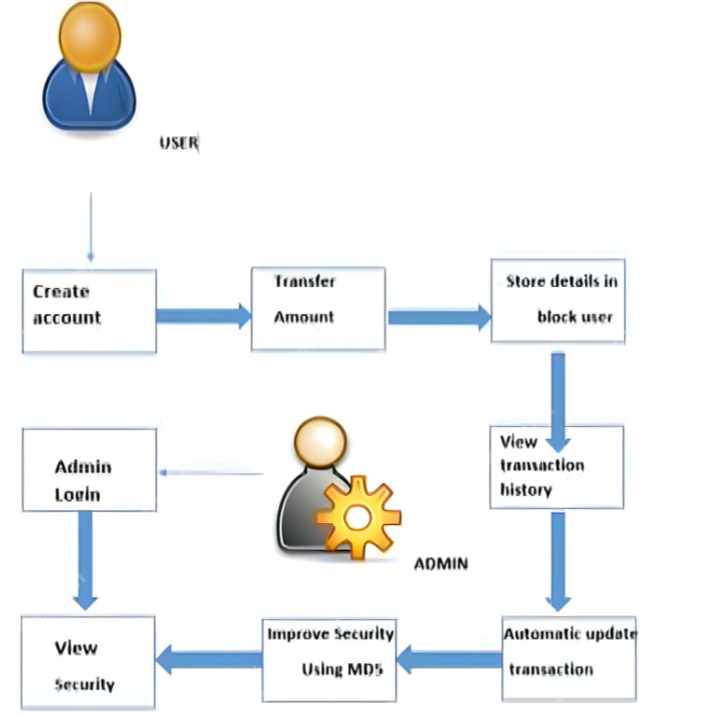
PROPOSED SYSTEM ARCHITECTURE

Slide 14
ADVANTAGES OF PROPOSED SYSTEM
By using the unmodifiable property of blockchain provide more security.
Confidentiality is transparent with each transaction visible to all the peers.
Run a application in offline mode.
Provide accurate and reliable information

Slide 15
SYSTEM SPECIFICATION
HARDWARE SPECIFICATION
Processor : I3 Processor above
Ram : 4 Gb.
Hard Disk : 500 GB.
Input device : Standard Keyboard and Mouse.
Output device : VGA and High Resolution Monitor.
SOFTWARE SPECIFICATION
Operating System : Windows.
Programming Language : Python and Java
IDE : Anaconda IDE

Slide 16
Conclusion
Block chain Technology is a standout amongst the most predictable advances when it requires monitoring money related properties.
Block chain innovation has pulled in numerous organizations that need to include the particular highlights of it to their security structures.
Block chain can likewise help in shortening the stream of dark cash and managing the broad cash cleaning in the economy in light of the fact that each location utilized for exchanges is put away perpetually on the databases, making every one of the exchanges provable and dependable.
The legislature is watching Block chain as an approach to investigate a scope of alternatives which may apply a fitter control on the country's economy.

Slide 17
REFERENCES
Nir Kshetri "Can Block chain Strengthen the Internet of Things?," IT Professional, vol. 19, no. 4, pp. 68 - 72, May 2017,
Dr.Mahdi H. Miraz, "Block chain: Technology Fundamentals of the Trust Machine," Machine Lawyering, Chinese University of Hong Kong, 23rd December 2017.
Xu H.Y. China’s Internet Financial Risks and Countermeasures. Inter- national Conference on Financial Management, Education and Social Science (FMESS 2017), 2017.
Akinyede R.O., Esese O.A. Development of a Secure Mobile E-Banking System. International Journal of Computer (IJC), Vol 26, No 1, 2017.
Gatali I.F., Lee K.Y., et.al a qualitative study on adoption of biometrics technologies: Canadian banking industry. In: Proceedings of the 18th Annual International Conference on Electronic Commerce: e-Commerce in Smart connected World, 2016.

